Slide 1
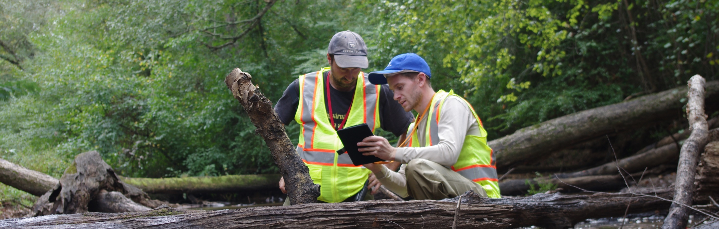
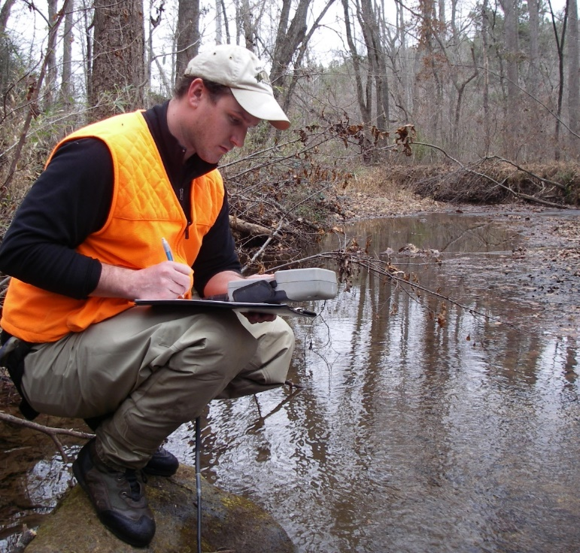
Coosa-North Georgia 303(d) Listed Streams
2021 North Georgia Water Resources Partnership Annual Meeting
Educational Seminar
Erin Lincoln, PH
Natalie Postel, PE
April 28, 2021

Slide 2

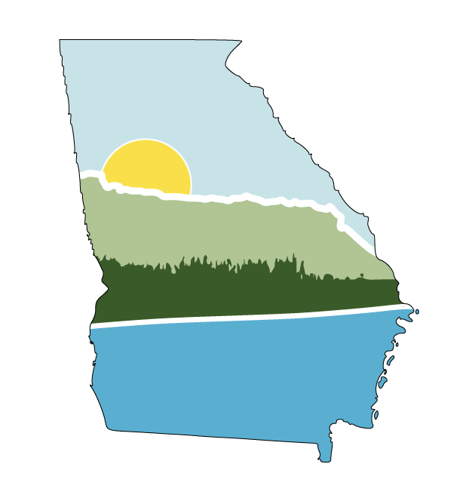

Thank You to our Supporters and Contributing Partners
Support from the Northwest Georgia Regional Commission and North Georgia Water Resources Partnership
Contributions from Hawks Environmental and CCR Environmental
Funding through an EPD 319 grant

Slide 3
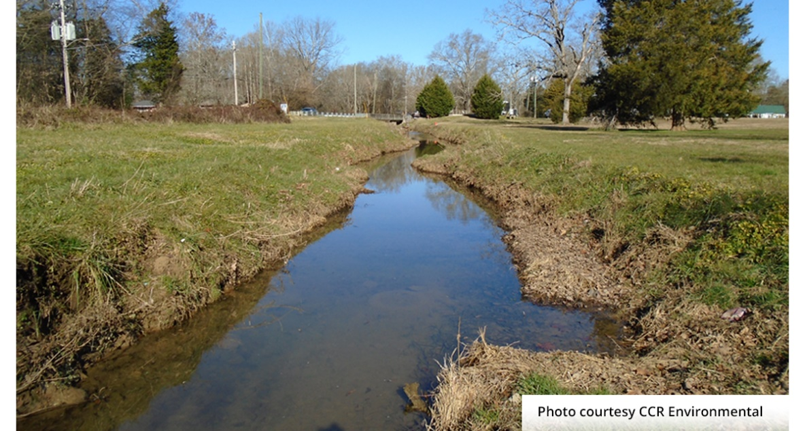
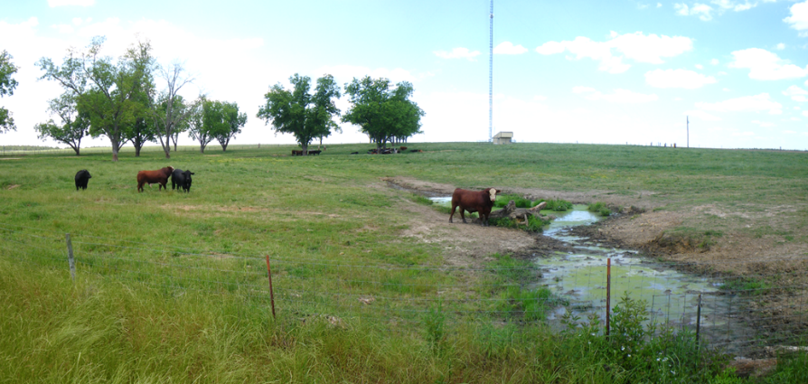
Project Goal
Develop an impaired stream water quality assessment tool to guide private citizens, watershed groups, local governments, and the Council and Partnership in prioritizing and delisting impaired 303(d) listed streams in the Coosa-North GA region.

Slide 4
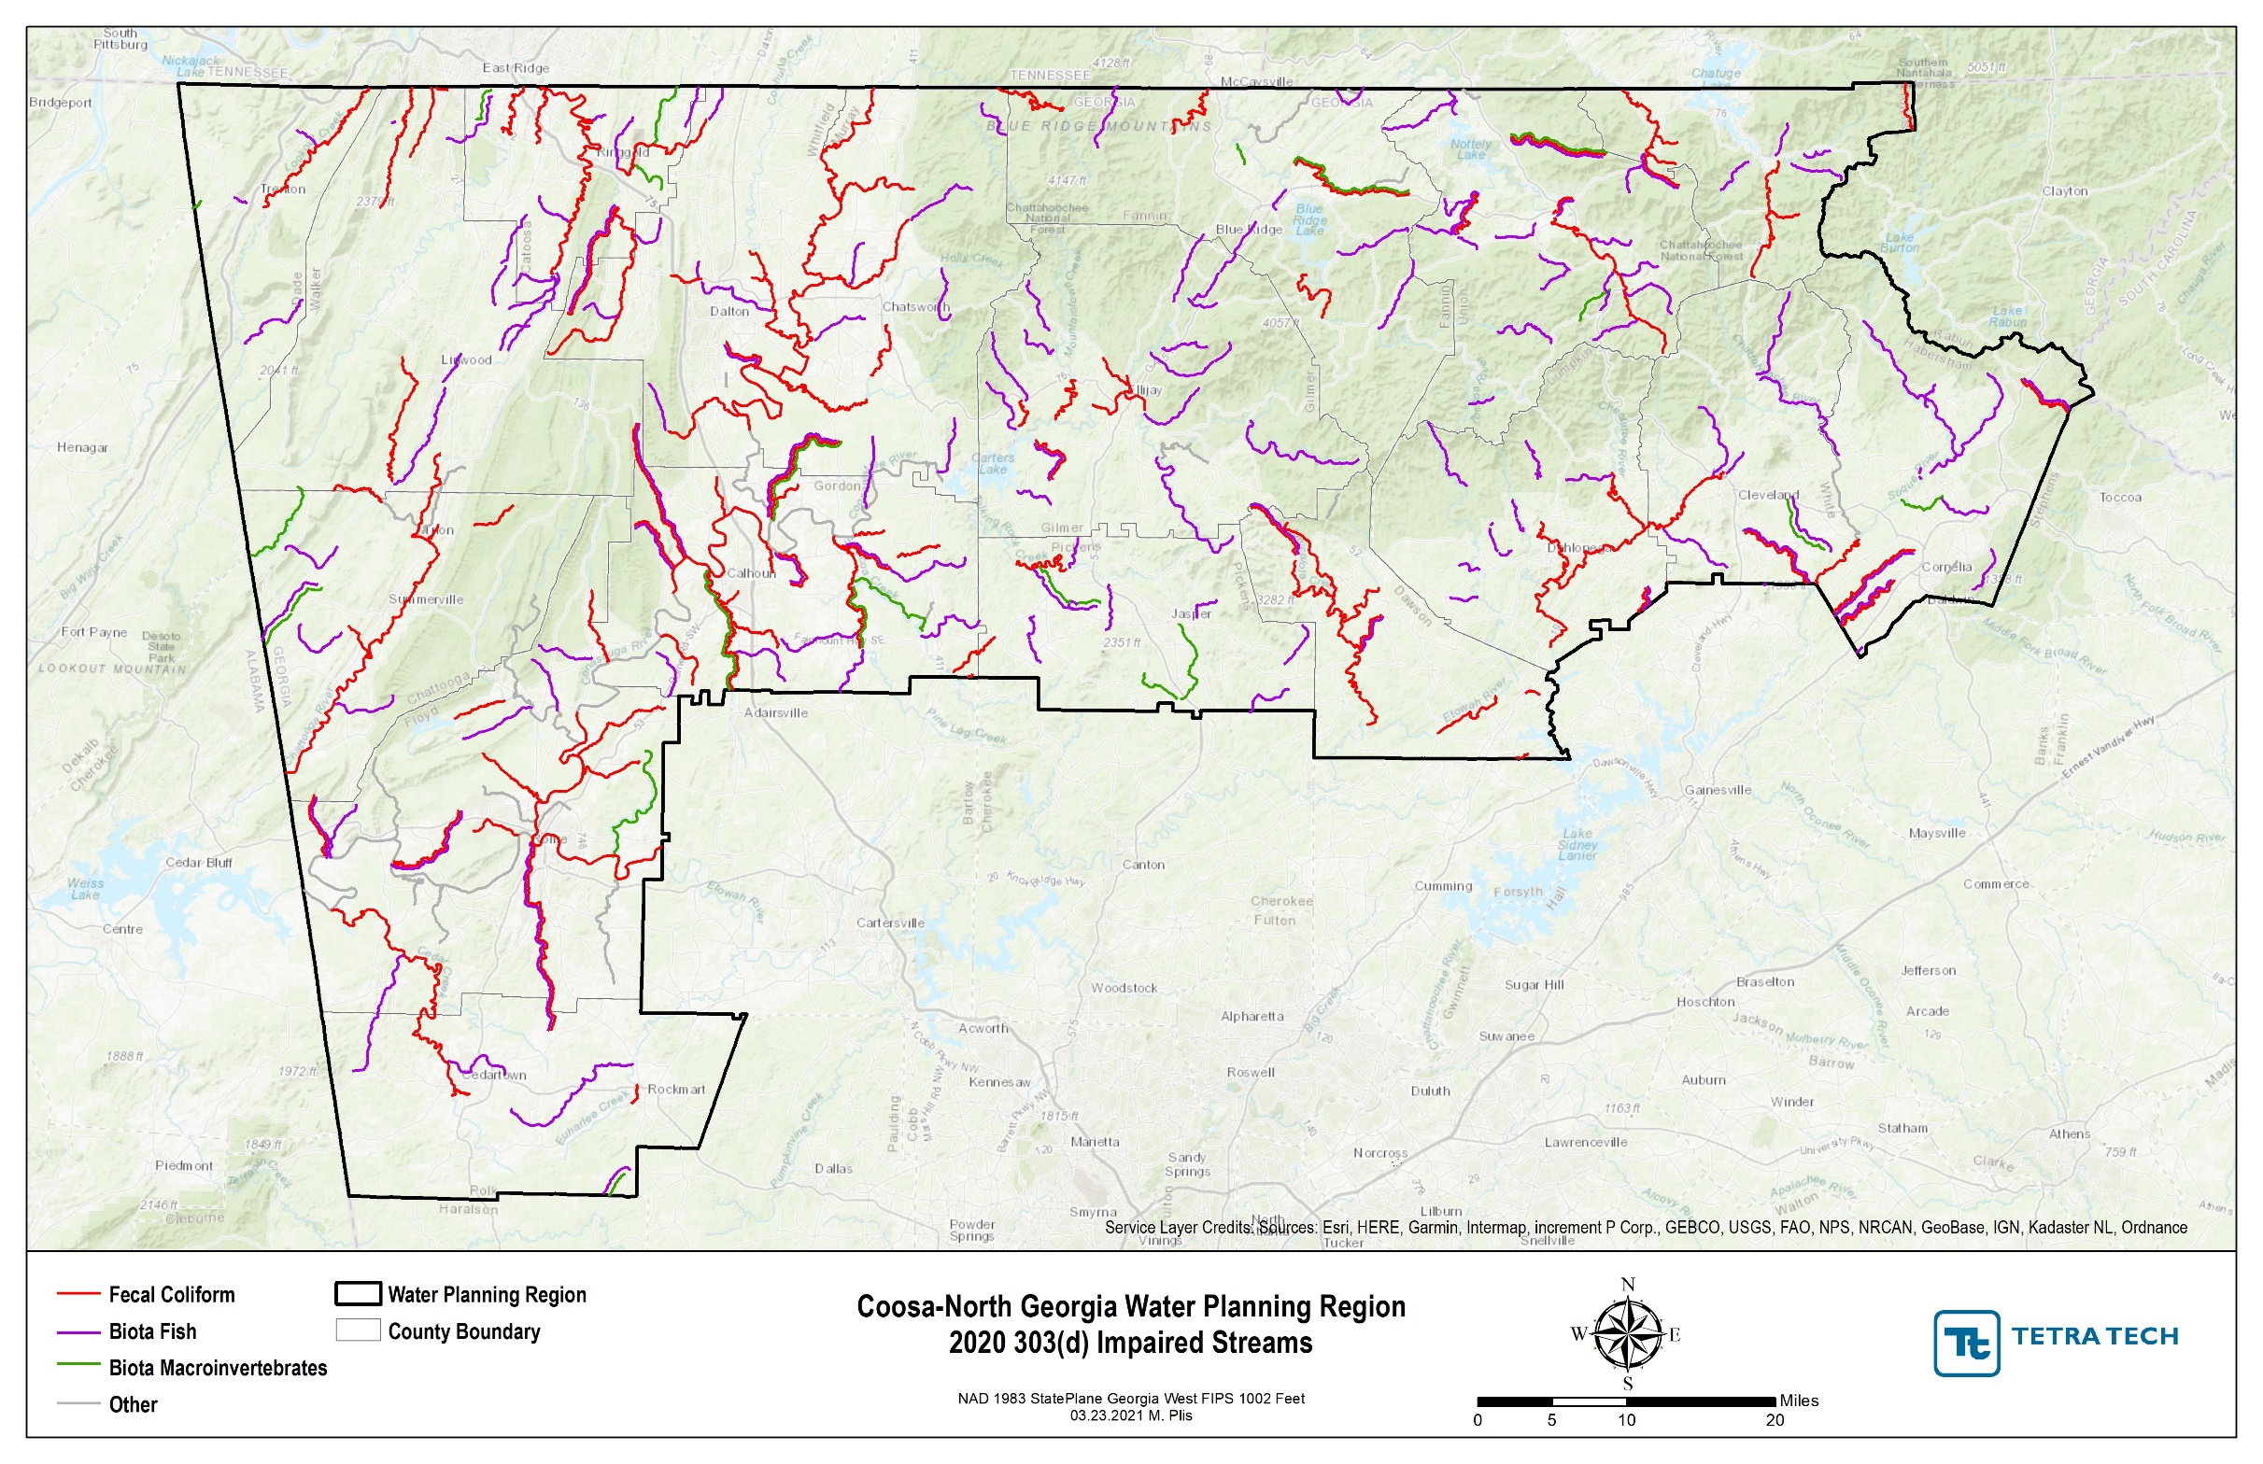
Impairment Cause | # Impaired Segments
Fecal coliform | 105
Biota fish/macro | 152
Other (PCBs) | 32
Other (DO, pH, temp, E. coli) | 20

Slide 5
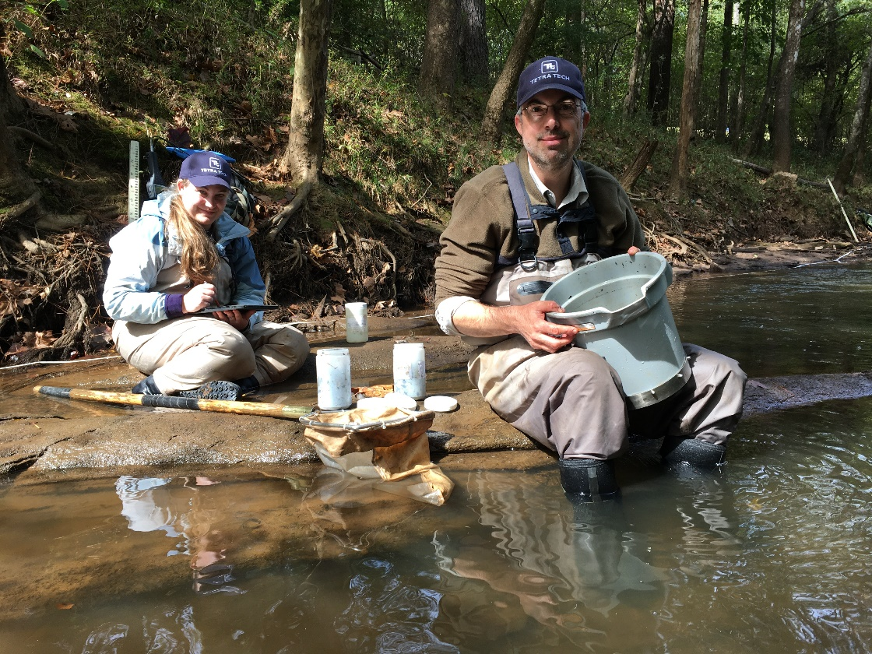
Project Activities and Tasks
303(d) Listed Streams Evaluation
  Public data collection & assessment
  Water Quality Listing Evaluation
Prioritization Tool Development
  Rate overall stream health
  Prioritize streams for delisting/management efforts
Water Quality Sampling Program
  Collect water quality and biota data
  Compare against prioritization tool results
Social Media Posts
  Facebook
  LinkedIn

Slide 6
303(d) Streams Evaluation

Slide 7










Water Quality Standards and
Listing Circumstances
Inventory of Possible Streams for Delisting
Water quality standards and scoring metrics
Listing data
Land Use
Point and non-point sources

Slide 8





Fecal Coliform Assessment Key Findings
12 impaired streams partially or fully located in national forests/wilderness areas
5 impaired streams with contributing areas >90% forested/wetland
6 impaired streams had low fecal coliform concentrations past two years
Potential Causes in Forested Areas
Decentralized Campsites
Hiking Trails
Wildlife

Slide 9
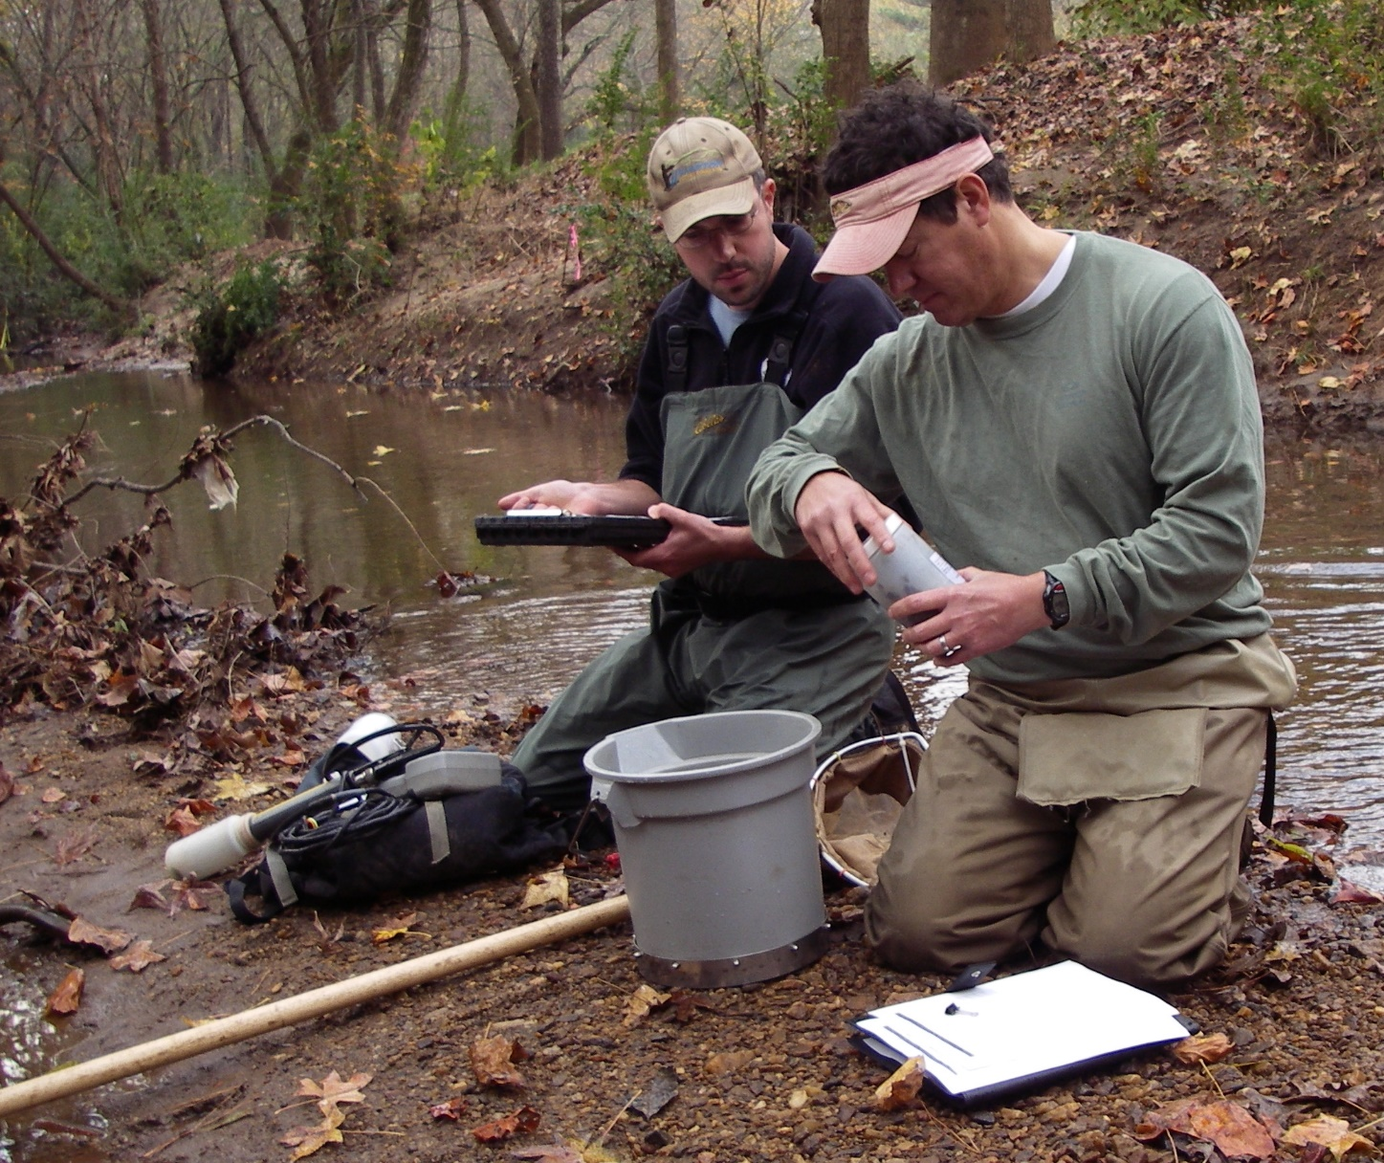
Biota Fish Assessment Key Findings
21 impaired designated trout streams with contributing areas >90% forested/wetland
15 impaired designated trout streams partially or fully located in national forests/wilderness areas
Working with EPD to assess fish index of biological integrity scoring

Slide 10
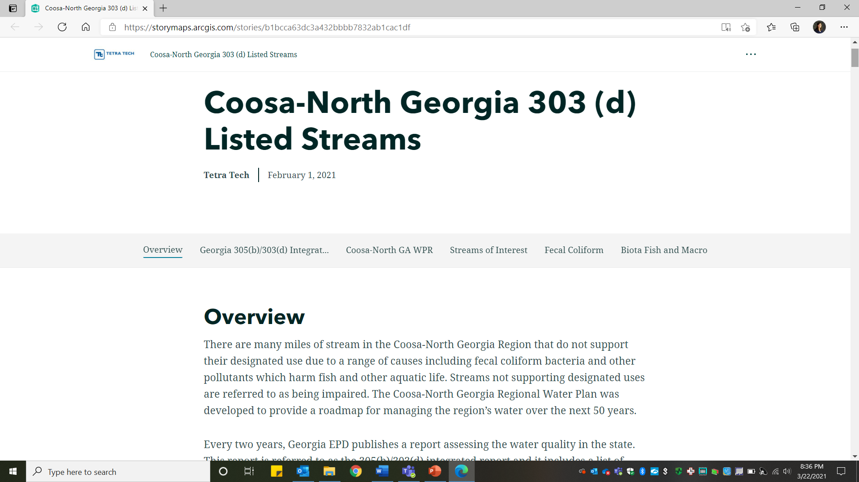
ArcGIS StoryMap
Coosa-North Georgia 303 (d) Listed Streams (arcgis.com)

Slide 11
Prioritization Tool Development

Slide 12
Prioritization Tool
Assessed current 303(d) listed stream for fecal/biota impairments
Stream Health Assessment
  25 factors and metrics to assess land use, human impacts, and water quality
  Metrics scored using weighted average based on data quality and client concerns
  Streams receive scores from 1 to 10, 10 being ‘healthy’
Prioritization Assessment
  7 prioritization metrics to assess opportunities for delisting of stream segments
  Prioritized reaches with high restoration/preservation potential based on current health, watershed size, ecological significance, and funding opportunities
  Metrics scored using weighted average based data quality and client concerns
  Streams receive scores from 1 to 10, 10 being ‘high priority’

Slide 13
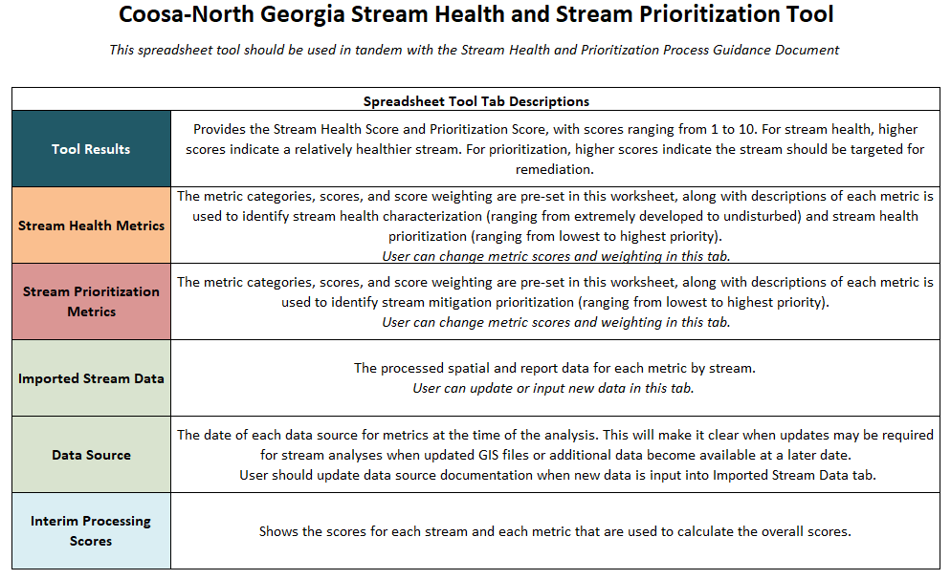
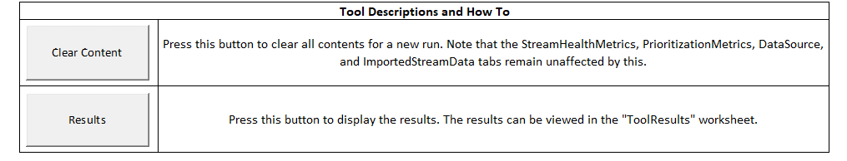

Slide 14
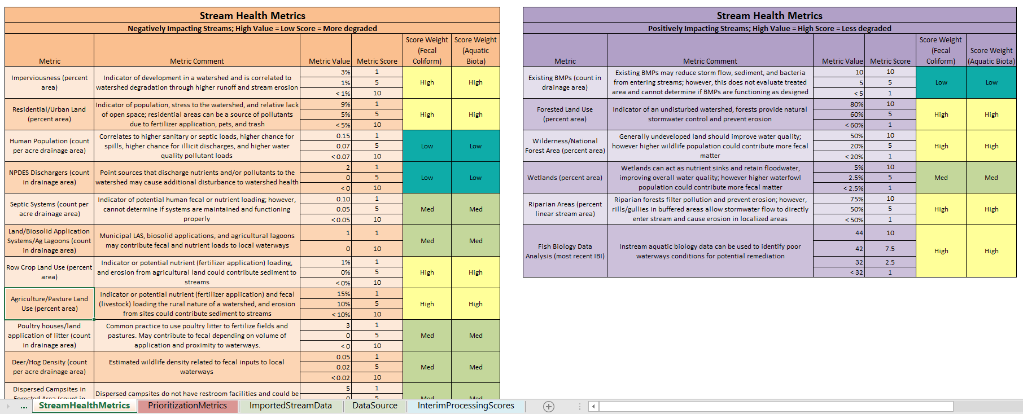
Stream Health Metrics

Slide 15
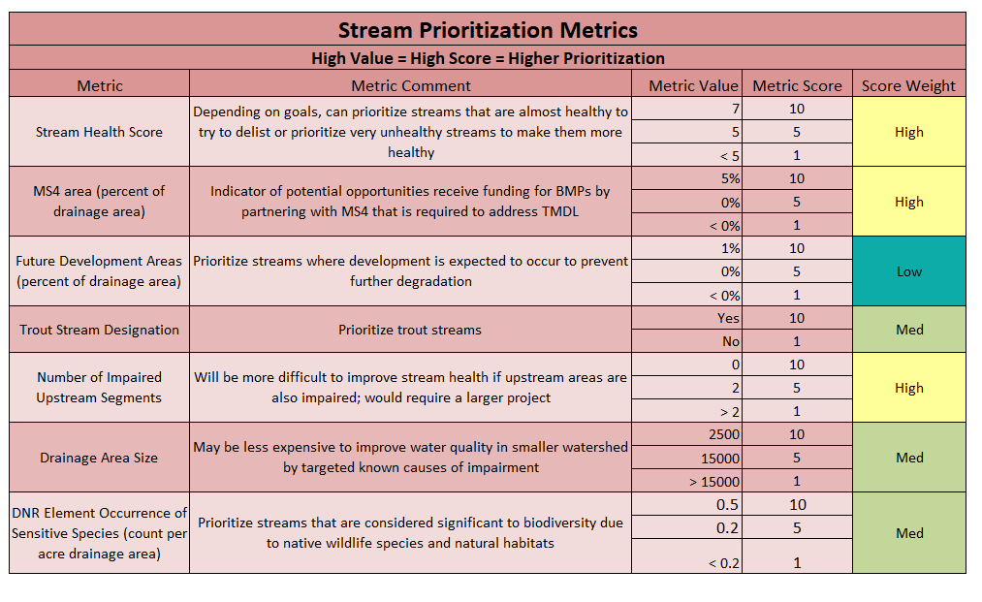
Prioritization Metrics

Slide 16
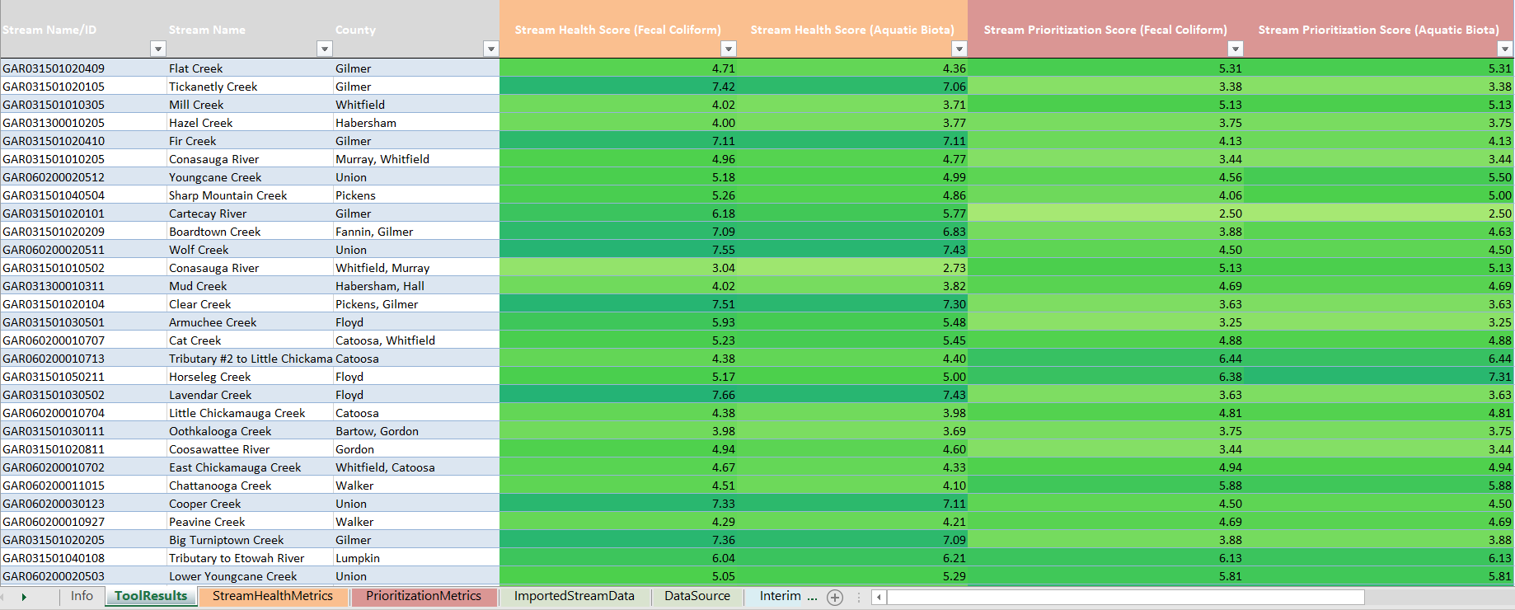
Stream Health/Prioritization Results

Slide 17
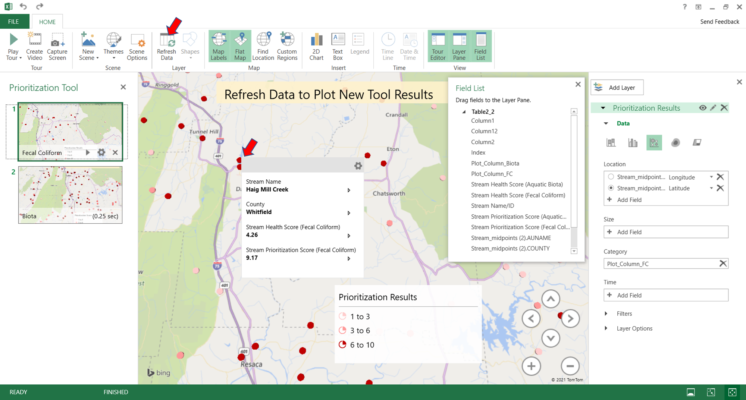
Stream Health/Prioritization Results

Slide 18
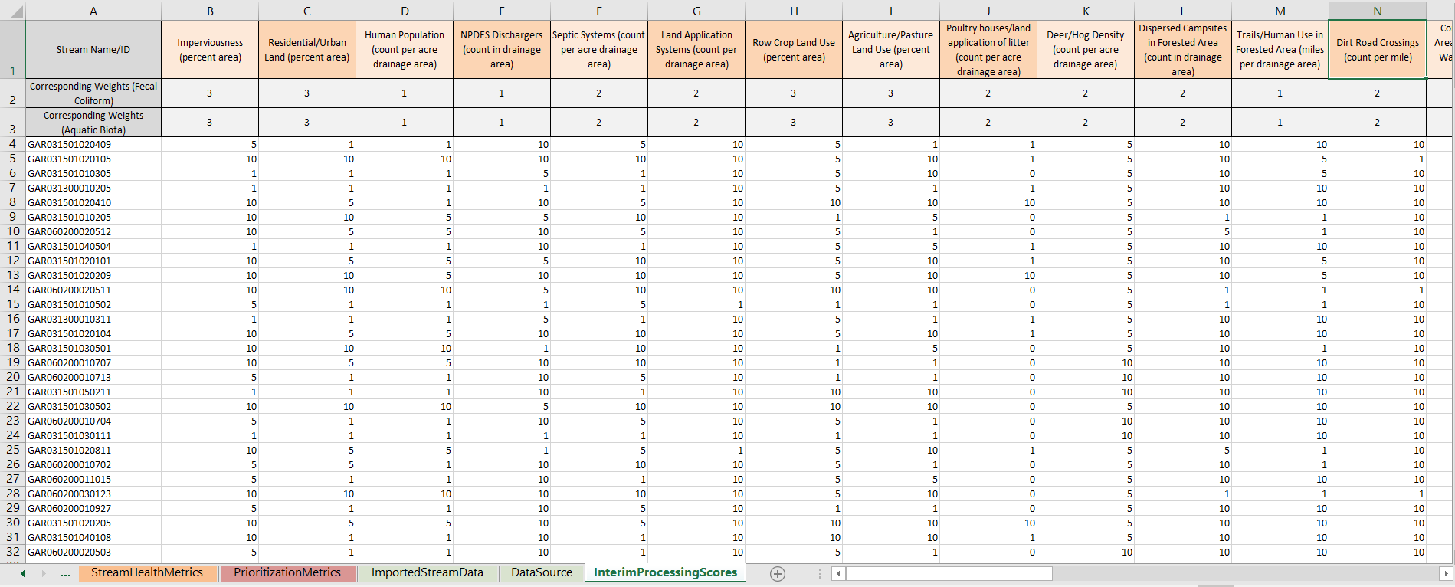
Interim Stream Health/Prioritization Results

Slide 19
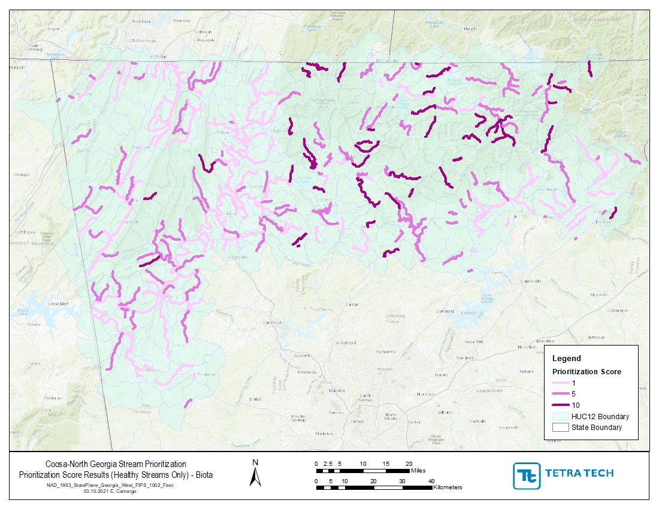

Slide 20
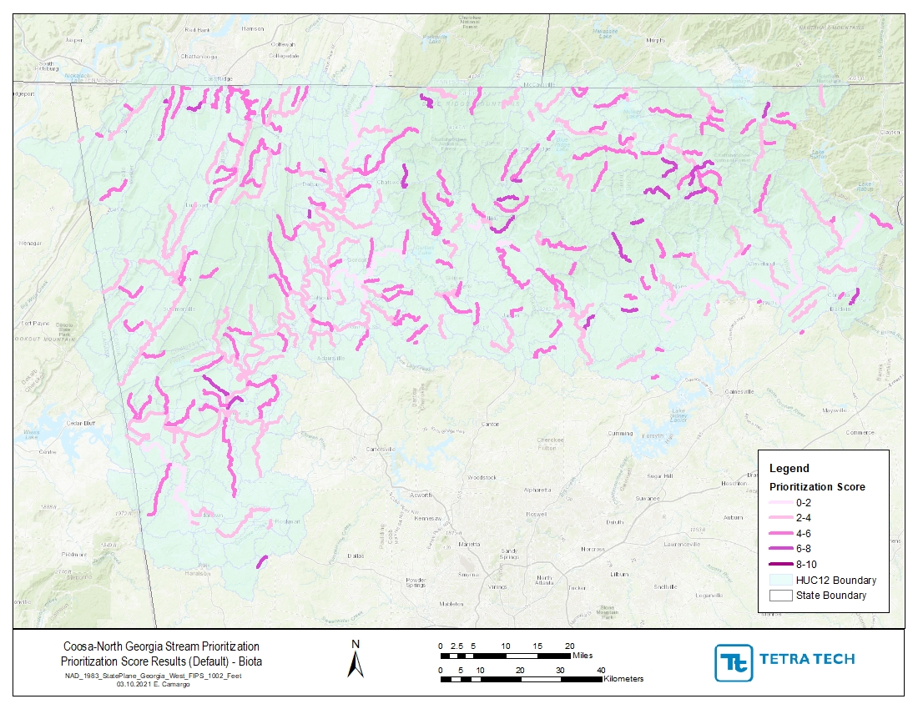

Slide 21
Water Quality and Biota Sampling

Slide 22

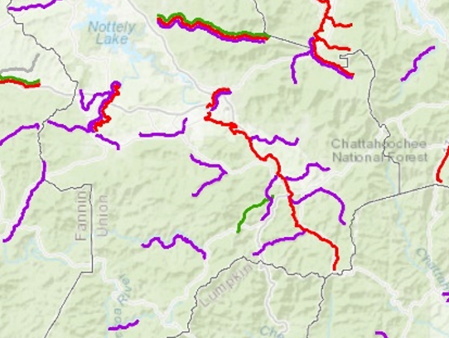
Recommended Sampling Locations
Nottely River (fecal coliform and E-coli)
  High stream health and prioritization scores
  Watershed partially located in national forest/wilderness areas
  Dominated by forested land uses
  No upstream fecal coliform impairments
  Recent low fecal coliform concentrations
Wolf Creek and Town Creek (biota fish)
  High stream health and prioritization scores
  Tributaries to Nottely River
  Small upstream drainage areas
  Designated trout streams
  Watersheds partially located in national forest/wilderness areas
  Dominated by forested land uses

Slide 23
GAEPD Sampling and Quality Assurance Plan
Sampling stations
Parameters
Schedule
Methods
Handling and custody
Analytical methods
Quality control
Data quality objective
GAEPD can use data in 305(b)/303(d) listing assessments

Slide 24
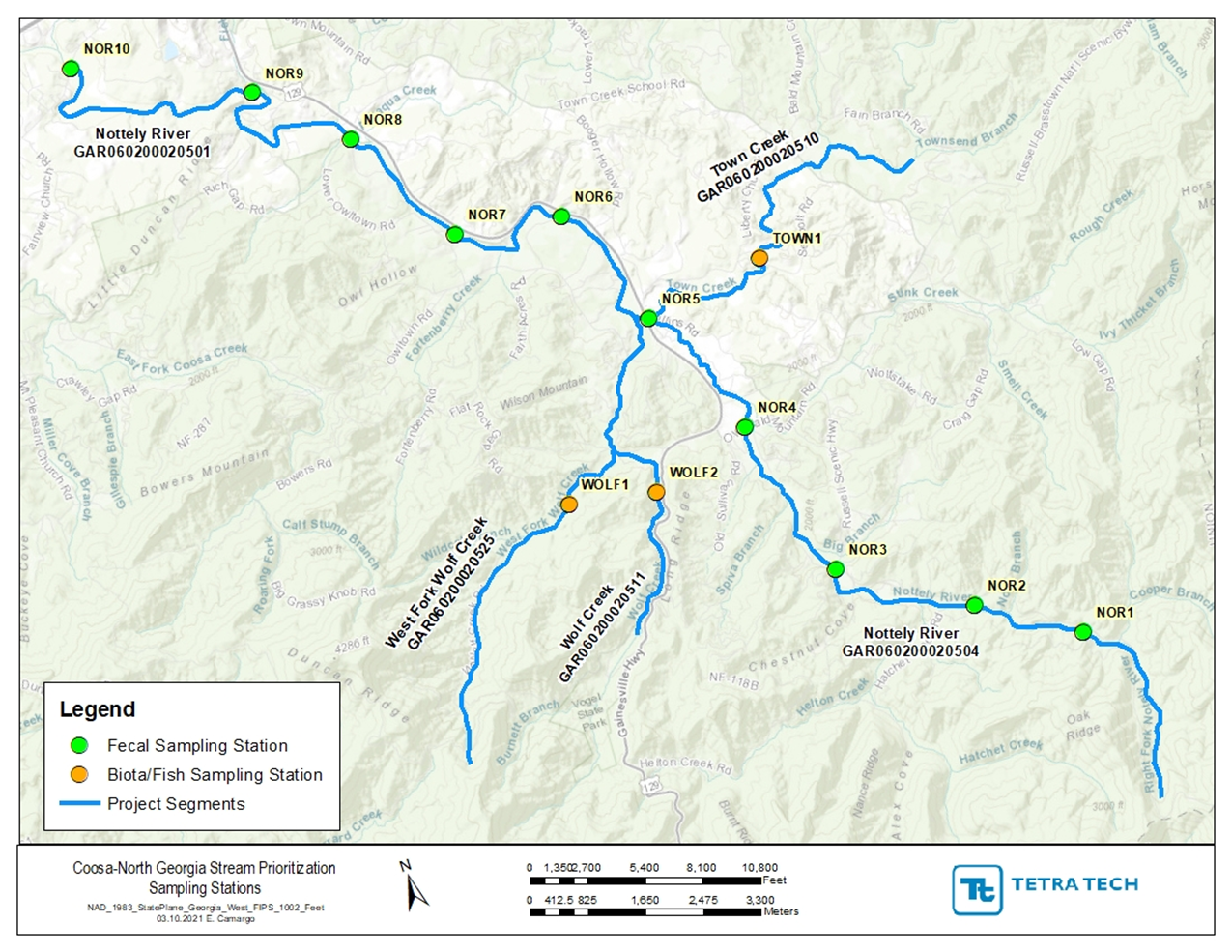
Nottely and Wolf Creek Sampling Locations
Nottely River
  10 Fecal coliform and E-coli sampling stations
West Fork Wolf Creek
  1 biota fish sampling station
Wolf Creek
  1 biota fish sampling station
Town Creek
  1 biota fish sampling station
All locations: temperature, dissolved oxygen, pH, conductivity, turbidity

Slide 25
Next Steps
Collect data over 10-months
Compare data with state standards to determine if any streams can be delisted
Validate scoring used in the prioritization tool and determine if any changes should be made to the tool
Recommend actions that could be taken to improve water quality
Final report summarizing results and recommendations

Slide 26
Questions?
Erin Lincoln, PH
erin.lincoln@tetratech.com
Natalie Postel, PE
natalie.postel@tetratech.com

